Slide 1

RWS Q2-W1-D2
CRITICAL READING
Text and Text Connections

Slide 2

Objective:
Distinguish between hypertext and intertext

Slide 3

“Quick Review”
Identify what is described in each statement.
1. ﻿It is defined as the social, cultural, political, historical, and other related circumstances that surround the text and from the ﻿terms from which it can be better understood and evaluated.

Slide 4

2. ﻿It is the modelling of a text’s meaning by another text.

Slide 5

3. It is a non-linear way of showing information. This information appears as links and is usually accessed by clicking.

Slide 6

4. ﻿This is seen when an author borrows and transforms a prior text, or when you read one text and you reference another.

Slide 7

5. It is the color of an unvisited link.

Slide 8
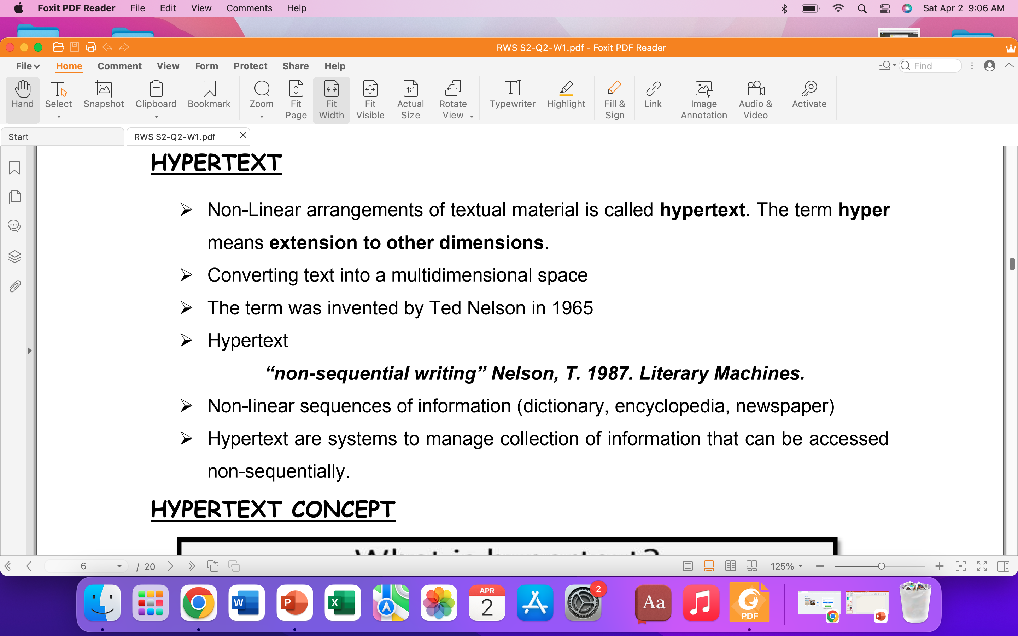
HYPERTEXT

Slide 9
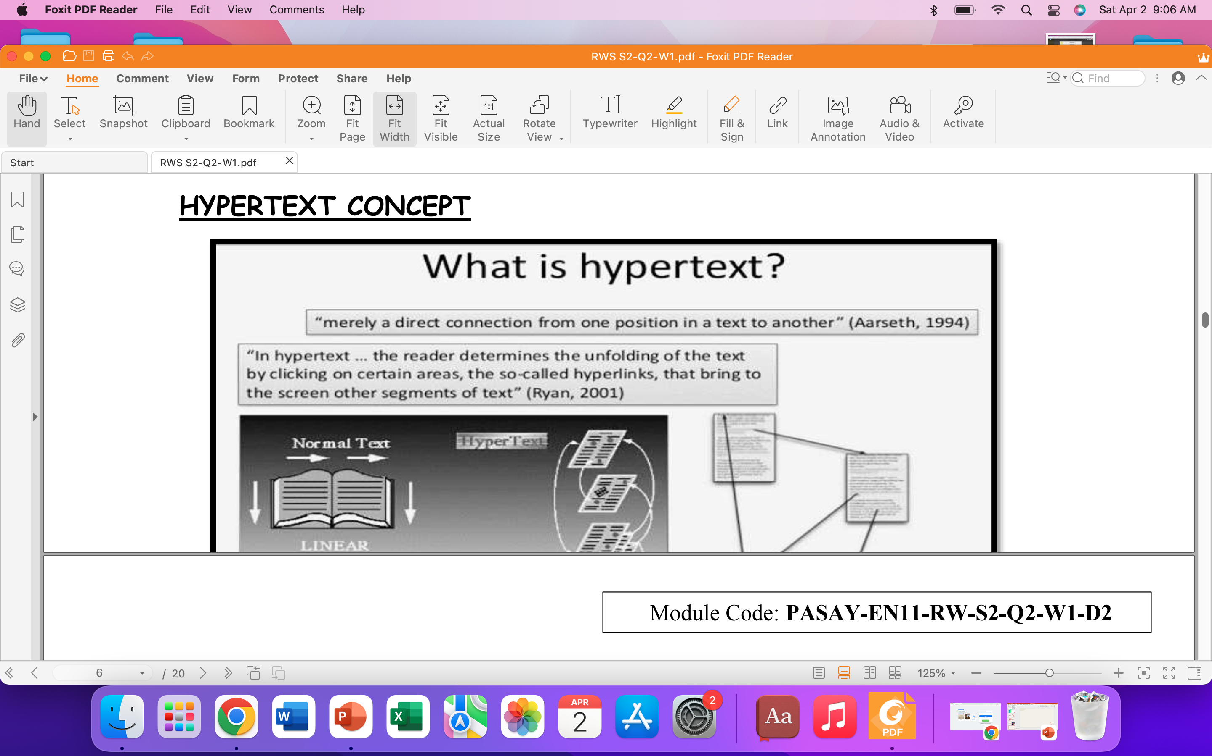

Slide 10
HYPERTEXT
﻿These are works which inform or help construct a text.
01
They can be from any medium but the main text relies on them to help construct meaning.
02
An intertext connects the studied text to media as a whole and stops the text from being isolated from other texts.
03

Slide 11
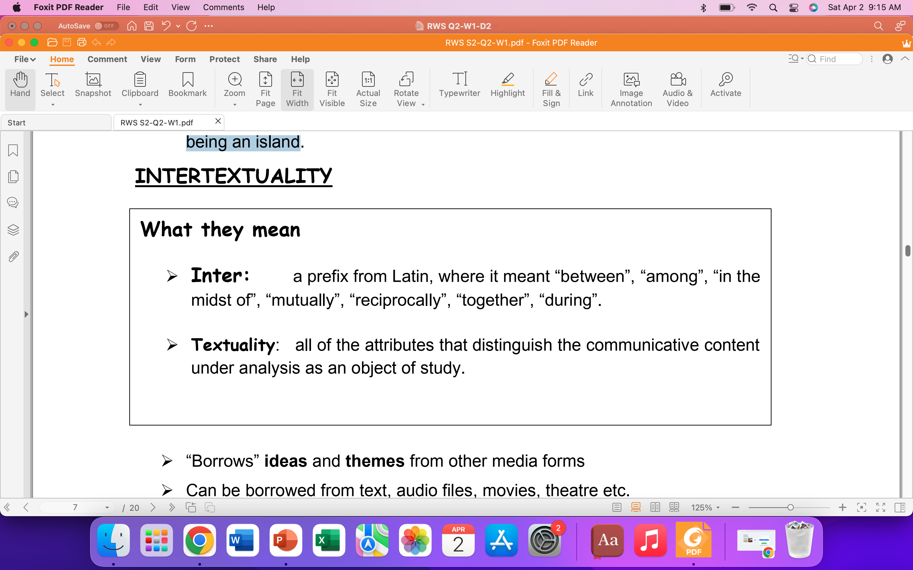

Slide 12
INTERTEXTUALITY
﻿Borrows ideas and themes from other media forms
Can be borrowed from text, audio files, movies, theatre etc.
Not to be associated with copyright, collusion
Various movies use intertextual references
Helps reader to better understand text

Slide 13
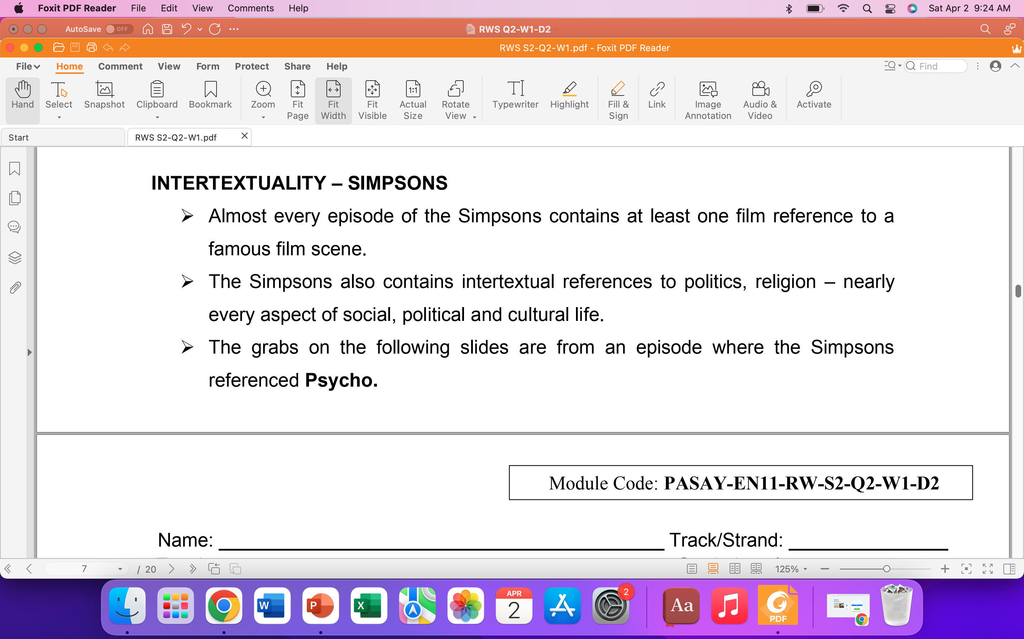
Example of Intertextuality

Slide 14
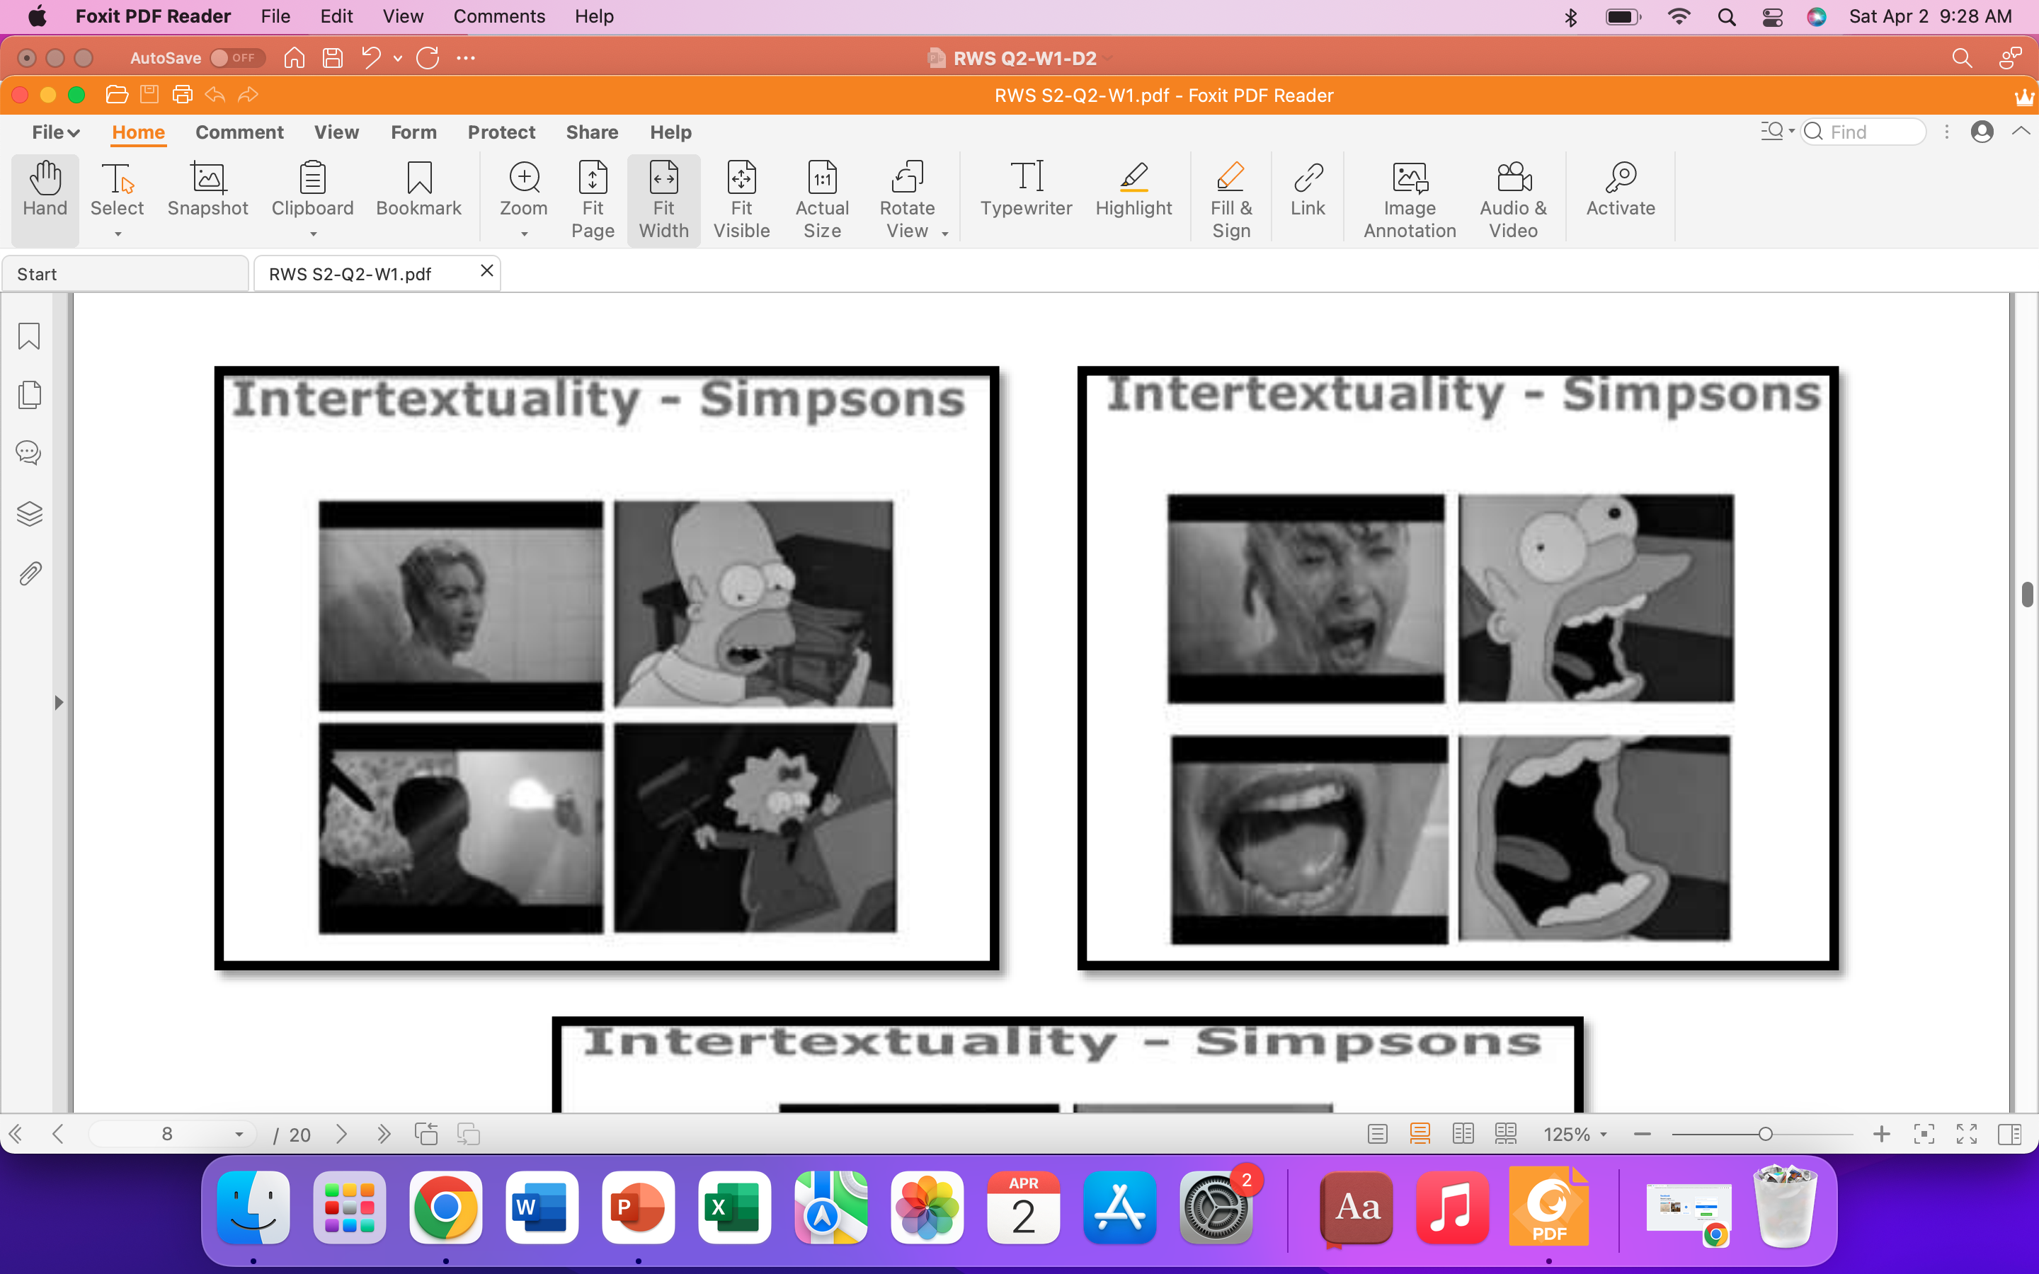

Slide 15
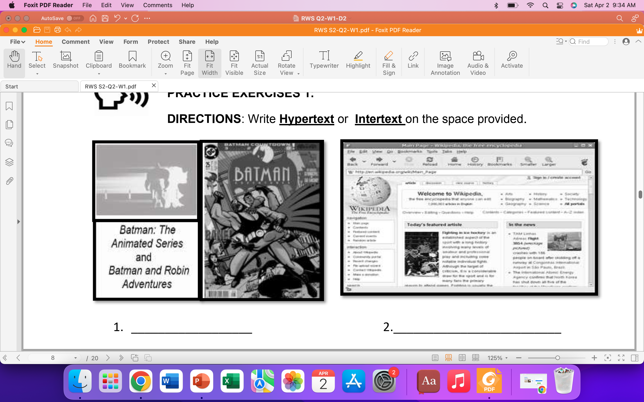
Tell whether the following shows intertext or hypertext.

Slide 16
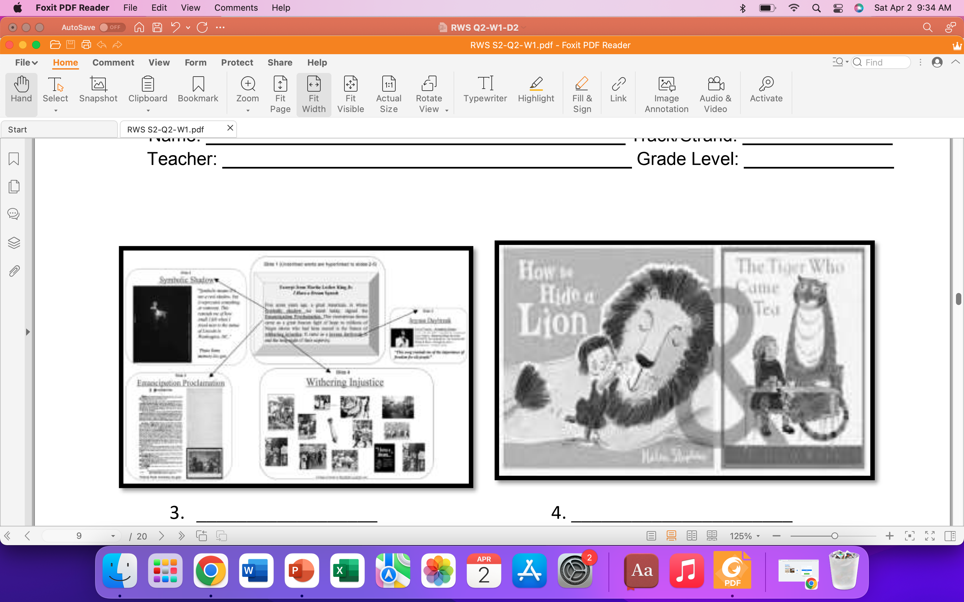

Slide 17
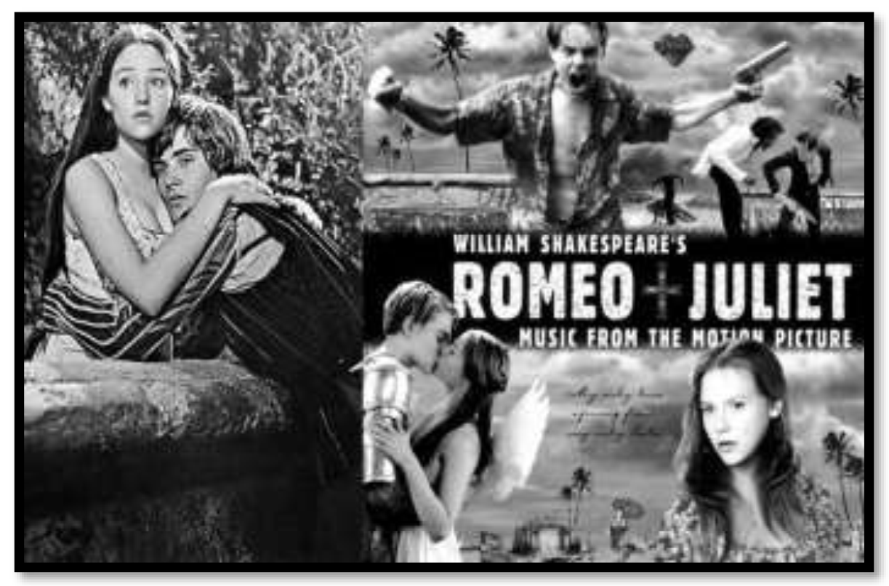

Slide 18
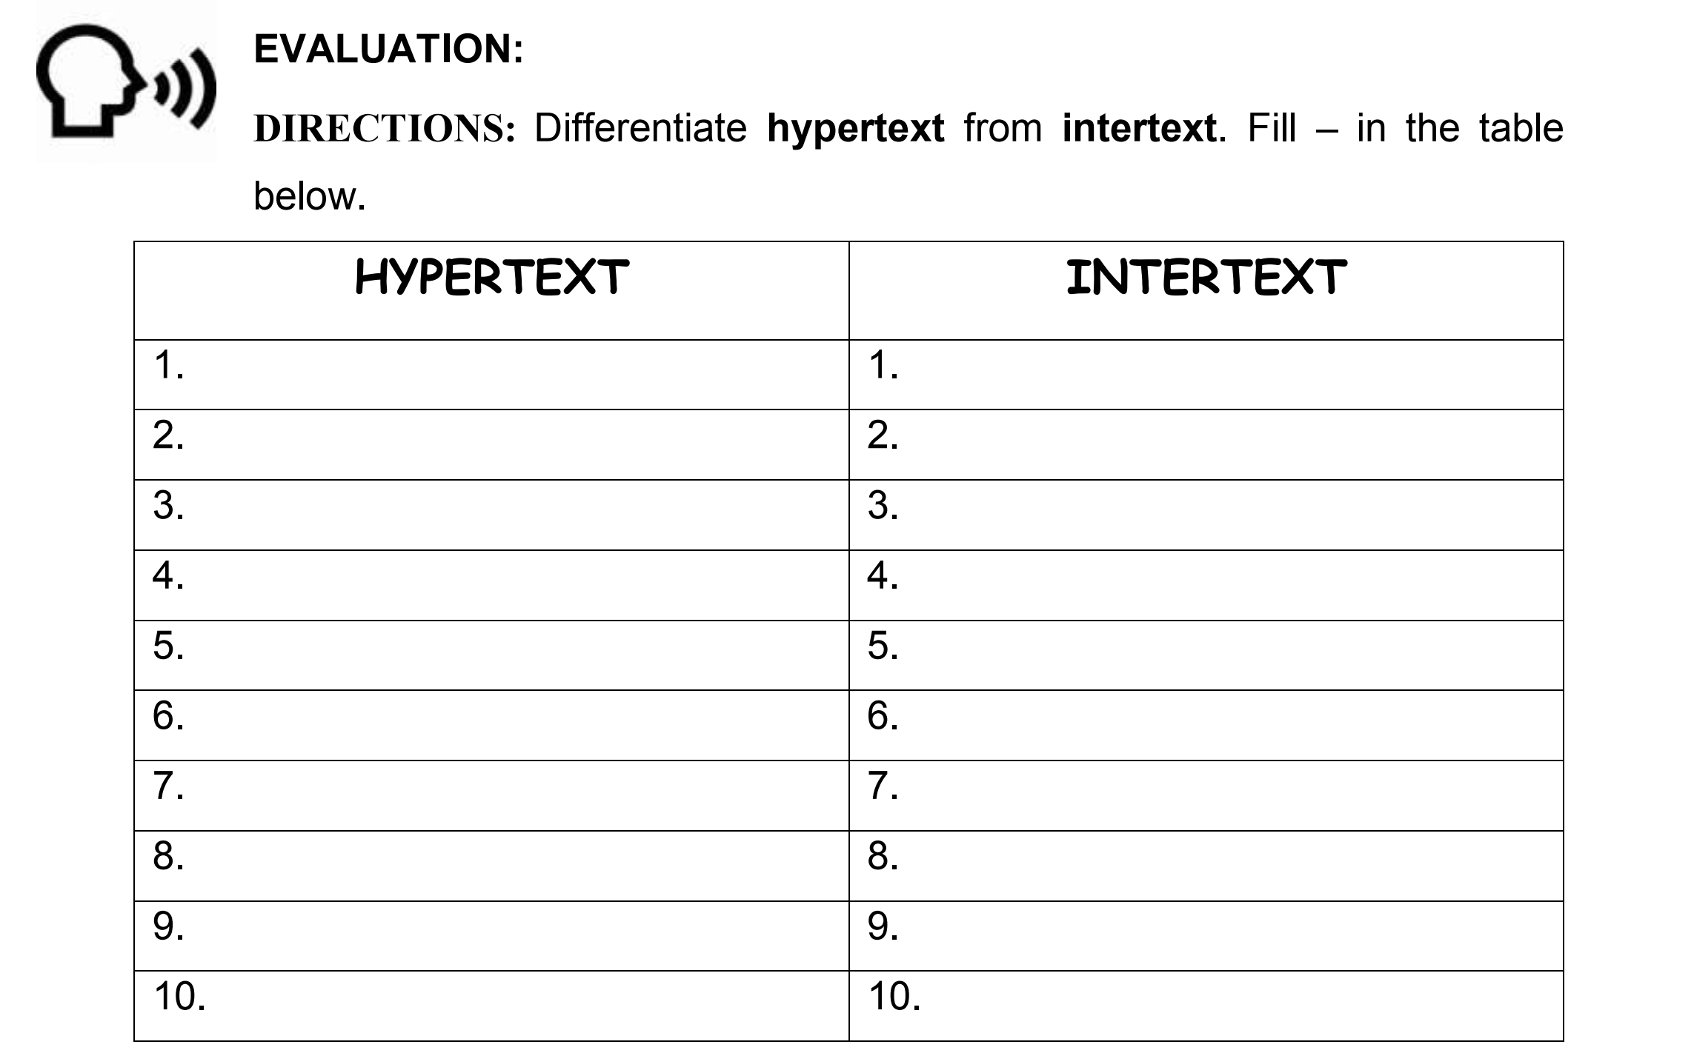
Your Task:

